Slide 1
Regional Growth Fund and Grant Opportunities
Gary Barnes, Deputy Secretary, Regional NSW
NSW Department of Premier and Cabinet

Slide 2
As of January 2019, $99,680,337 of successful projects under Regional Growth Funds in Western Division Councils, including:
Connecting County Communities / Mobile Black Spots: 7
Growing Local Economies: 2
Regional Communities Development Fund: 1
Regional Cultural Fund: 24
Regional Growth – Environment and Tourism Fund: 2
Regional Sport Infrastructure Fund: 3
Stronger Country Communities:190

Slide 3
The NSW Government has a clear hierarchy to guide investment in Regional NSW.
Notes:
Amenity Providing quality services and infrastructure in regional NSW
Growth Aligning effort to support growing regional centres
Potential Identifying and activating economic potential
How the Vision fits with other strategies:
The regional growth plans, NSW State Infrastructure Strategy and Future Transport Strategy 2056 provide a long-term road map of how the government will use its enablers of infrastructure and planning (which shape the business environment) to maximise long-term sustainable growth and amenity across the state.

Slide 4
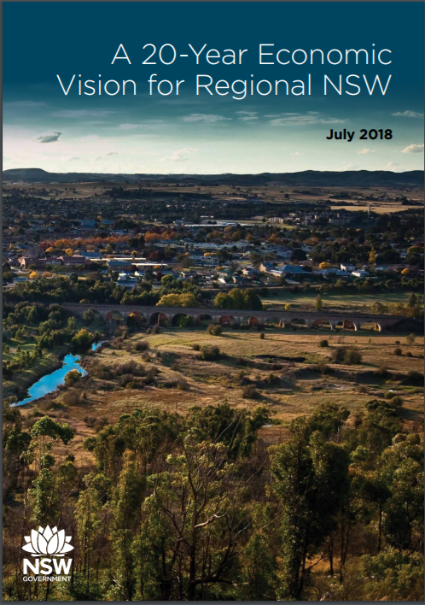
A 20-Year Economic Vision for Regional NSW sets the principles for regional development …
Notes:
On top of the Regional Development Framework’s three core objectives (amenity, growth, potential), we are focused on seven key principles to guide us when making decisions on regional economic development. These principles are aligned with the economic enablers.
The Vision and principles that underpin it are the Government’s blueprint for future investment, including the Snowy Hydro Legacy Fund.
The Vision will guide the allocation of resources from the new $4.2 billion Snowy Hydro Legacy Fund.

Slide 5
… and the engine industries driving the economic future of regional NSW.
Notes:
The ‘engine industries’ that will drive regional NSW economies over the next 20 years include seven established sectors, and three emerging sectors that are gaining ground in their share of the regional economy.

Slide 6
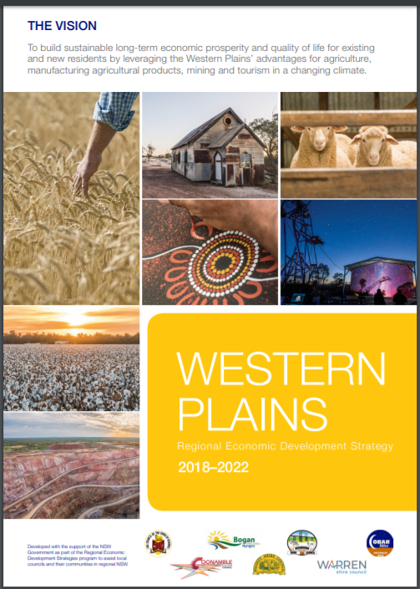
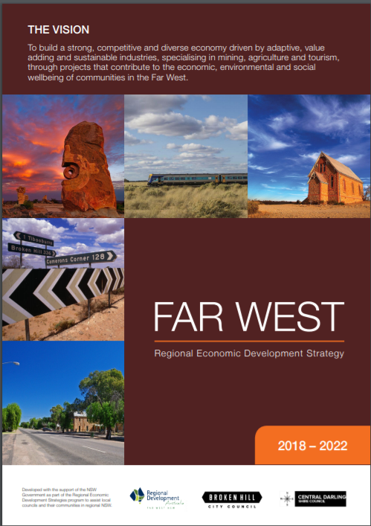
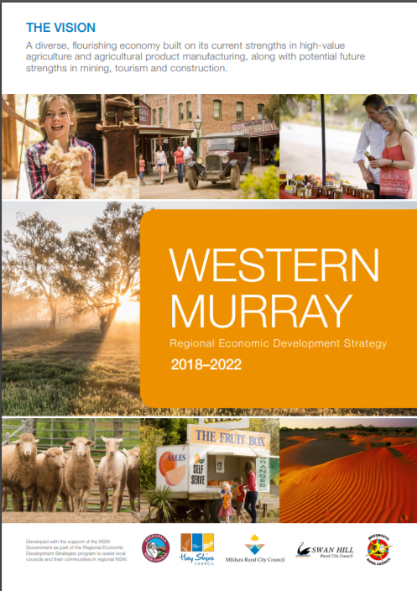
REDS outline each FER strengths and set aside separate pools of funding.

Slide 7
The Snowy Hydro Legacy Fund
Parkes and Wagga Wagga have been declared Special Activation Precinct
+ more under investigation.
Notes:
Business cases are being developed to identify projects in these five focus areas:
Providing water security in priority catchments: recognising the Hunter, Gwydir, Macquarie, Lachlan, Richmond and Bega as the highest priority areas for water security improvements through policy and infrastructure solutions.
Improving rail and road passenger transport connections: exploring opportunities to invest in infrastructure that makes travel between regional centres and to metropolitan areas faster and easier.
Improving freight linkages: improving regional freight networks to global gateways and the development of an air freight hub in regional NSW that will allow producers to deliver meat, dairy, fruit, nuts and seafood around Australia and the world as quickly as possible.
Improving digital connectivity across regional NSW: exploring infrastructure to provide faster and more reliable digital connectivity across regional NSW, improving liveability, productivity and innovation in regional NSW. Business cases will explore regional data hubs, high-capacity ‘backbone’ data links to Sydney, and improved connectivity and data access for businesses.
Activating regional locations for increased business investment: providing attractive locations and conditions for targeted industries to invest in regional NSW. Work is already underway to build an inland port in Parkes as a Special Activation Precinct that will leverage investment in inland rail.
Work is already underway on some of these projects and the first studies will be completed in early 2019.

