Slide 1
Western Division Conference 2019 Auditing Local Government
Margaret Crawford, Auditor-General
26 February 2019

Slide 2
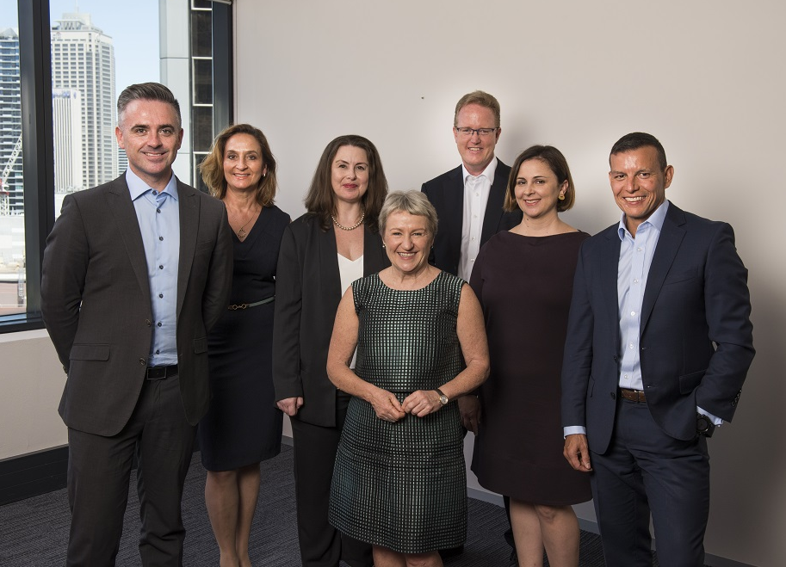
About Us
Our vision:
Our insights inform and challenge government to improve outcomes for citizens.
Our mission:
To help parliament hold government accountable for its use of public resources
Margaret Crawford, Auditor-General of NSW and the Audit Office Exec Team.

Slide 3
Local Government Audit mandate* - at a glance
Financial audit of all NSW Councils
Performance audit – sector wide or individual Councils
Sector report to Parliament – annual report on the results of all audits
* Under the Local Government Amendment (Governance and Planning) Act 2016

Slide 4
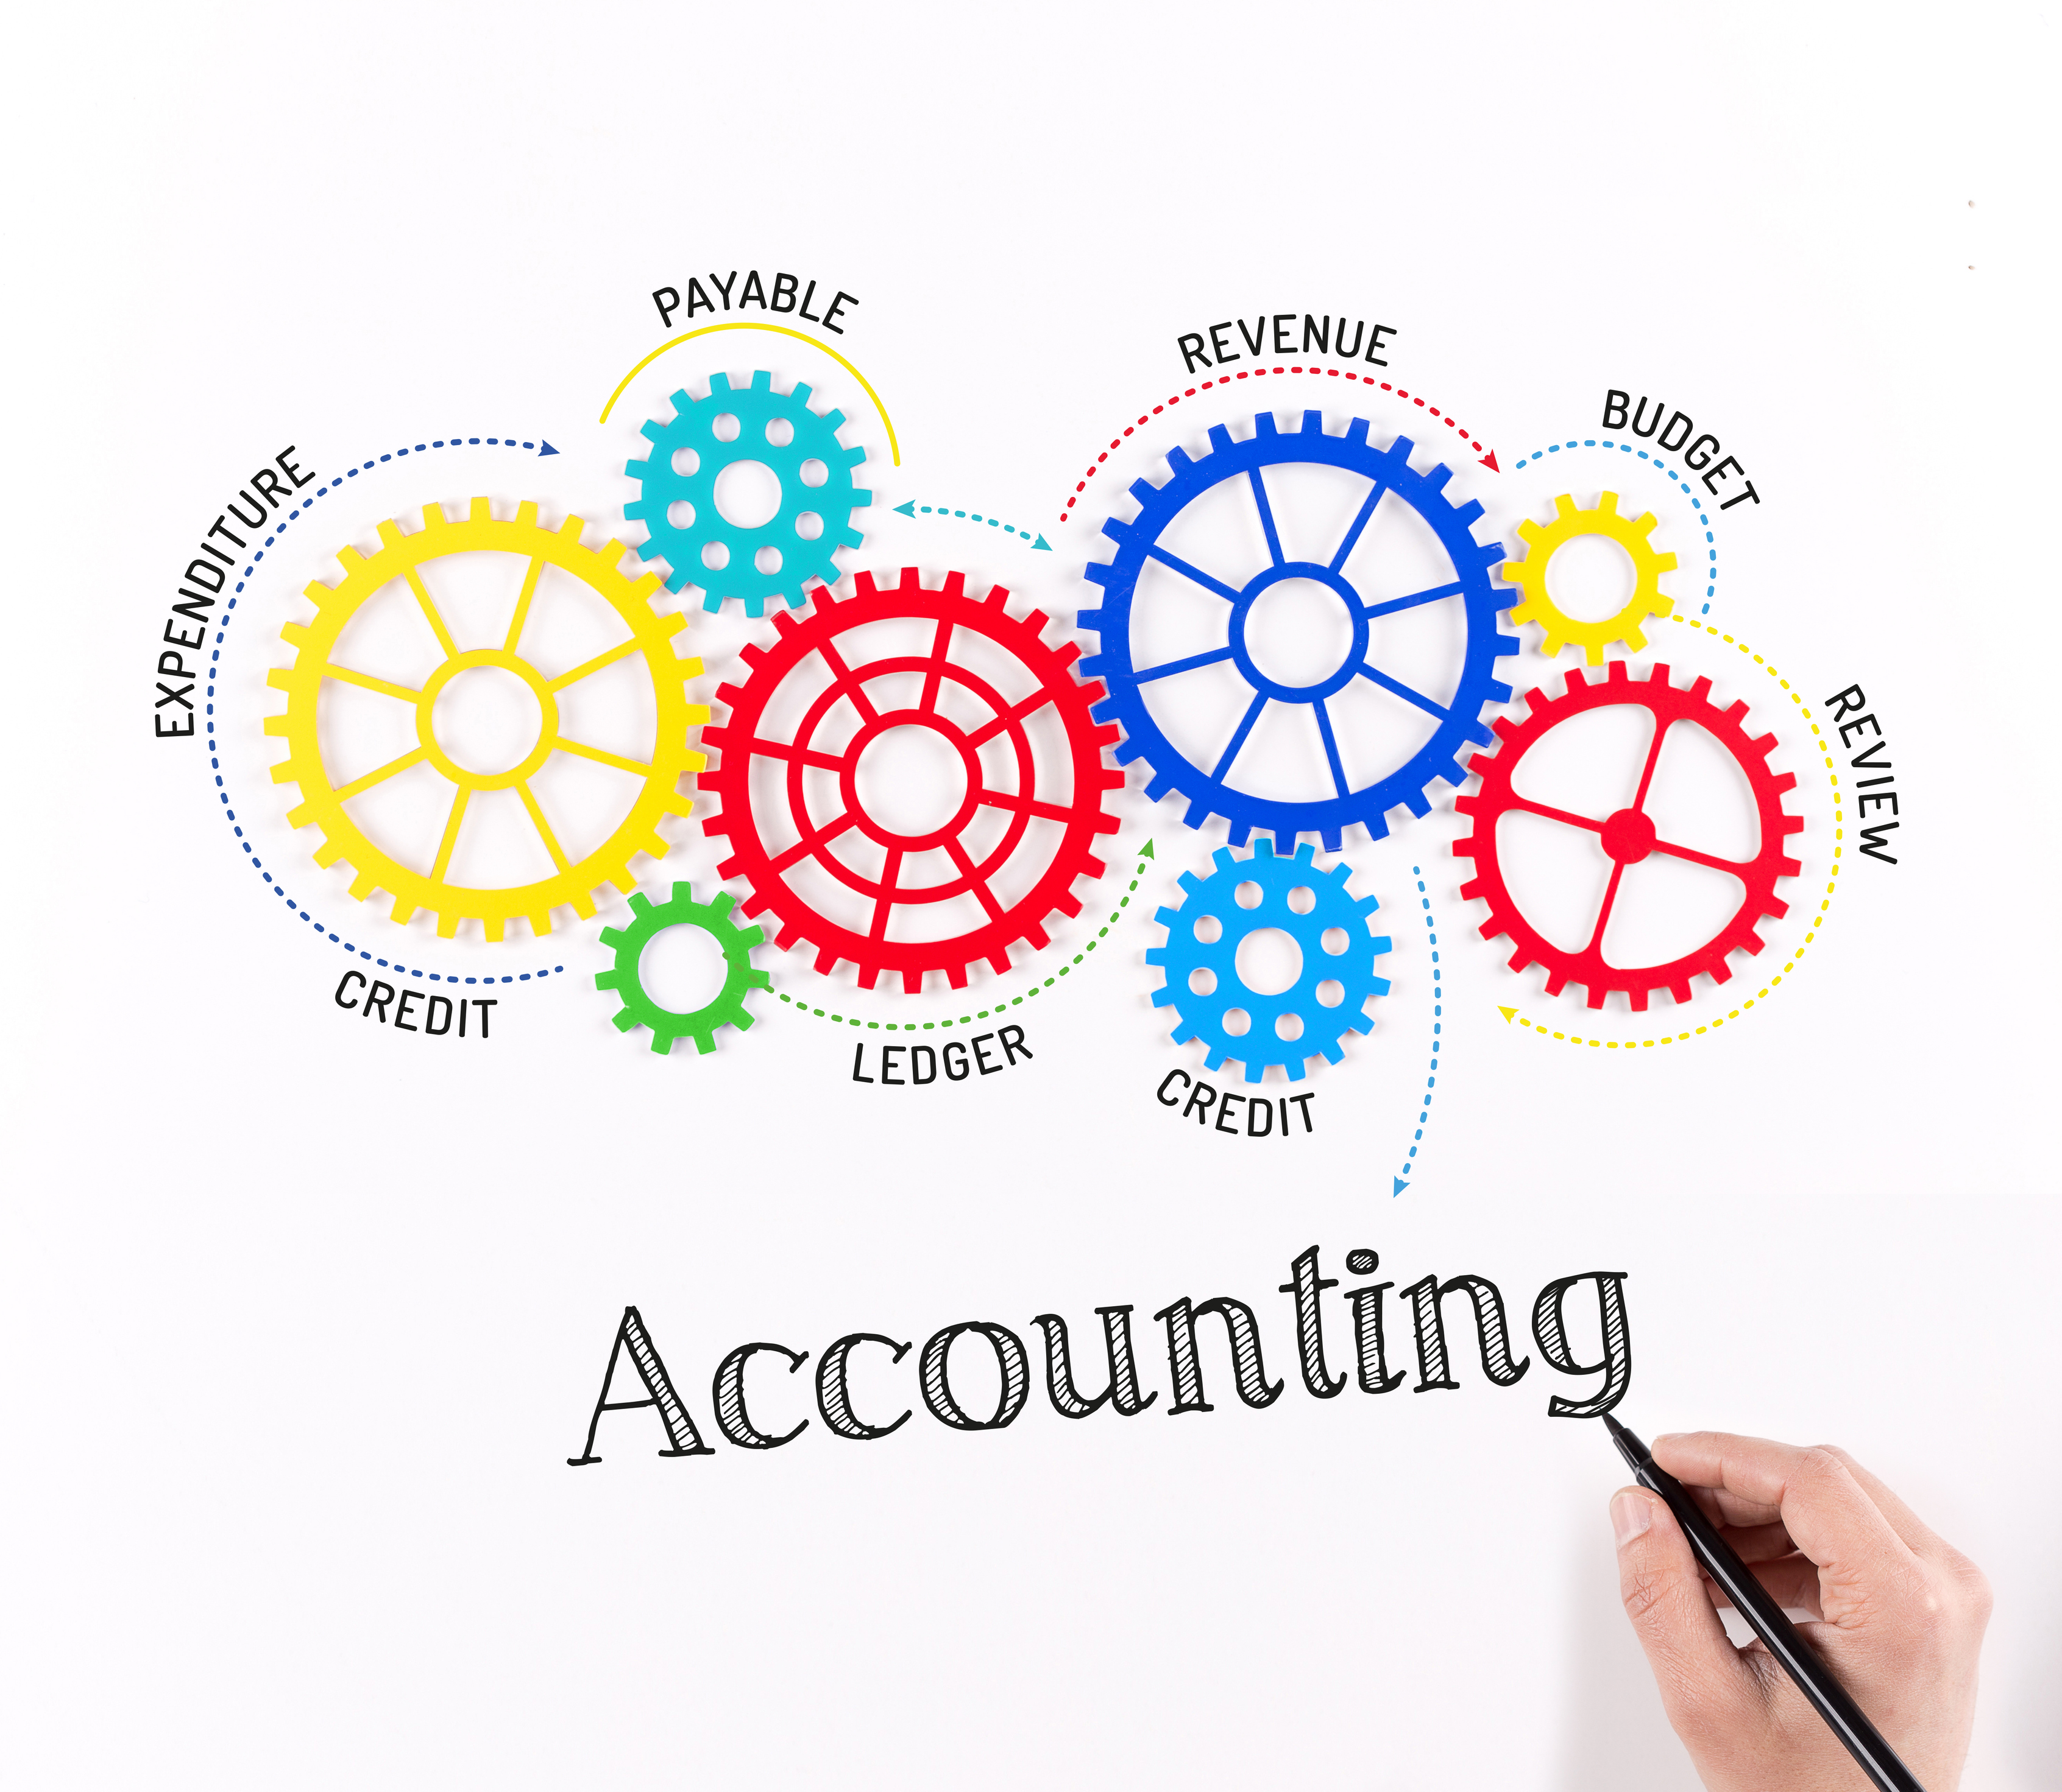
Immediate Impacts of new mandate
Sector Impact
Increased cost
Increased expectations
Audit Office Impact
30% increase in workload
Understand new sector
New partnerships
New business model

Slide 5
Insights from first two years
Strengths
unique and diverse
close to people they represent
commitment to community outcomes
Challenges
financial sustainability
capability – staff and elected officials
relationship with state and commonwealth governments
integrity/trust

Slide 6
Value Add?
Consistency
Benchmarking
Improved standards
Audits focused on key risks and performance gaps
Recommendations to councils and to state government
Best practice guidance

Slide 7
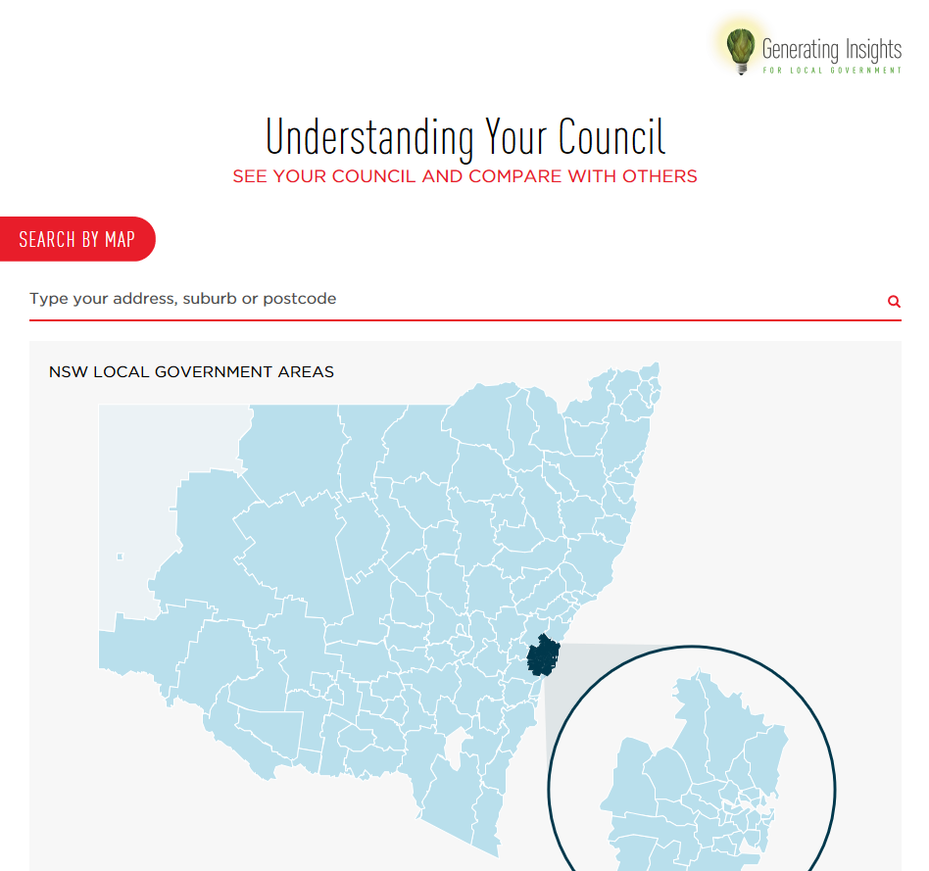
Sector Report to Parliament
Expect to table 28 February 2019
Results of 2017-18 audits
Highlights improvements across the sector, but more work to do
Topics include:
Financial Reporting
Governance and Internal Controls
Information technology
Asset Management
Financial Performance and Sustainability
Data Visualisation
Video

Slide 8
Changes to arrangements in 2018-19
Bring in-house an additional 16 audits
Open tender process
Cost of audit set through a competitive process
Longer term contracts

Slide 9
Performance auditing – the basics
Examines efficiency, effectiveness, economy and compliance
Identifies trends, good practices and performance improvement opportunities
Supports continuous improvement across the sector
Funded by NSW Government

Slide 10
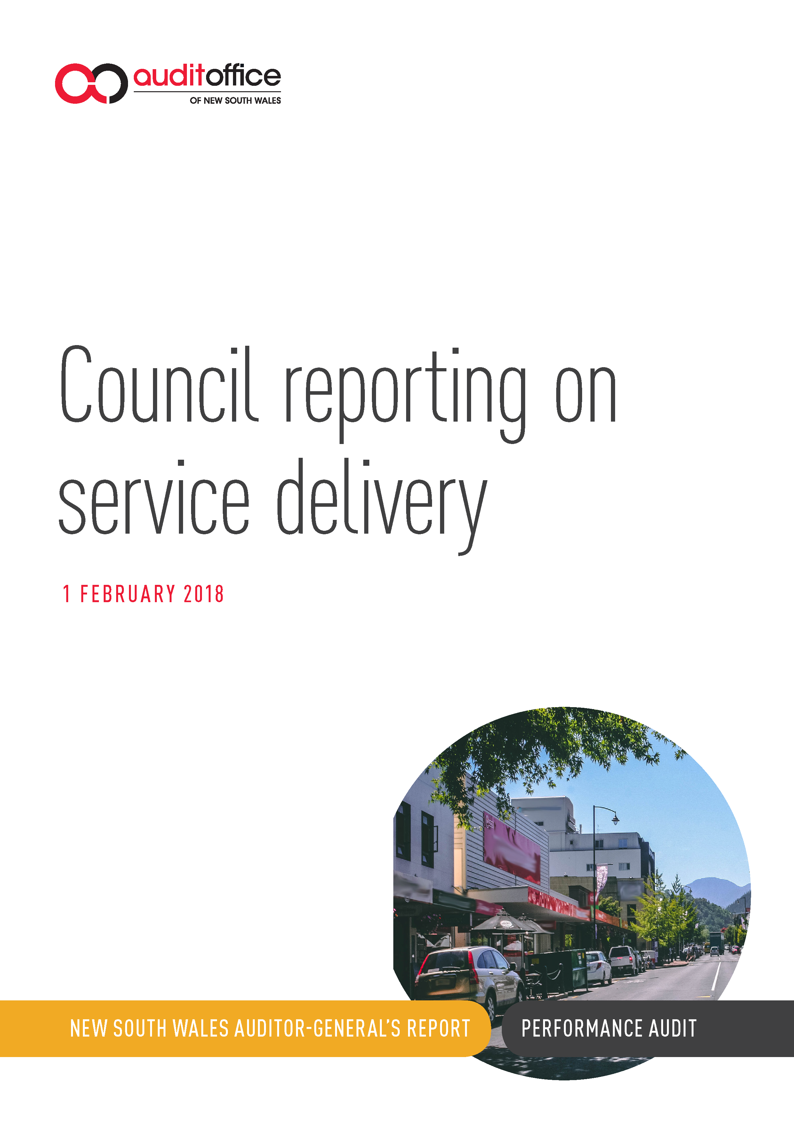
Local Government Performance Audit

Slide 11
Annual work program
Planned audits to 30 June 2019
Waste Management in Local Government
Amalgamation: Managing staff implications
Development applications
Future program is subject to change as more input received.

Slide 12
Notes:
Questions?

