Slide 1
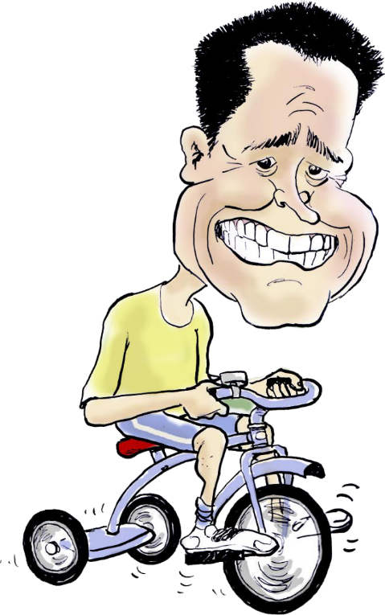
Mathew Dickerson
Award Winning Businessman
Best IT Business in Australia
Microsoft Worldwide Partner of the Year
IT Columnist and Commentator
Fairfax Media, TechGenix, ABC Radio
Award Winning Author
SBR, SLAM, From the Coal Face
Community Advocate
Last ever Mayor of Dubbo City Council
Founder of Tour de OROC

Slide 2
Chinese Whispers

Slide 3
ORIGINAL MESSAGE
Cost shifting to local government is good because people have more confidence in the State Government.

Slide 4
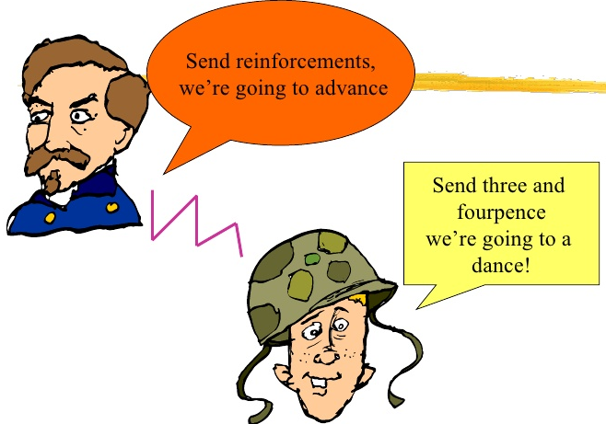
Urban Myth from World War I

Slide 5
Community Needs Survey Results

Slide 6
The World has Changed
24 Jun 1989: Internet in Australia. Now 89%.
1997: 71% Print News Read Weekly. Now 36%.
4 Feb 2004: Facebook introduced. Now 2.27B.
2011 – More news was read online than offline.
22 March 2012 – My lightbulb moment.
Capture of Malcolm Naden.
Time to get on-board…

Slide 7
Facebook Statistics
76% of all Australians on Facebook (>14yo).
43% receive their news via Facebook.
Check in 8 times/day for a total of 58 mins/day.
50% of 18-24yo wake up and check Facebook.
Penetration of social media in Australia.
95% of all users 12-24yo.
89% of all users 25-54yo.
57% of all users 55+…

Slide 8
Community Needs Survey Results

Slide 9
CONVINCED?
What are the important tips to communicate the message?

Slide 10
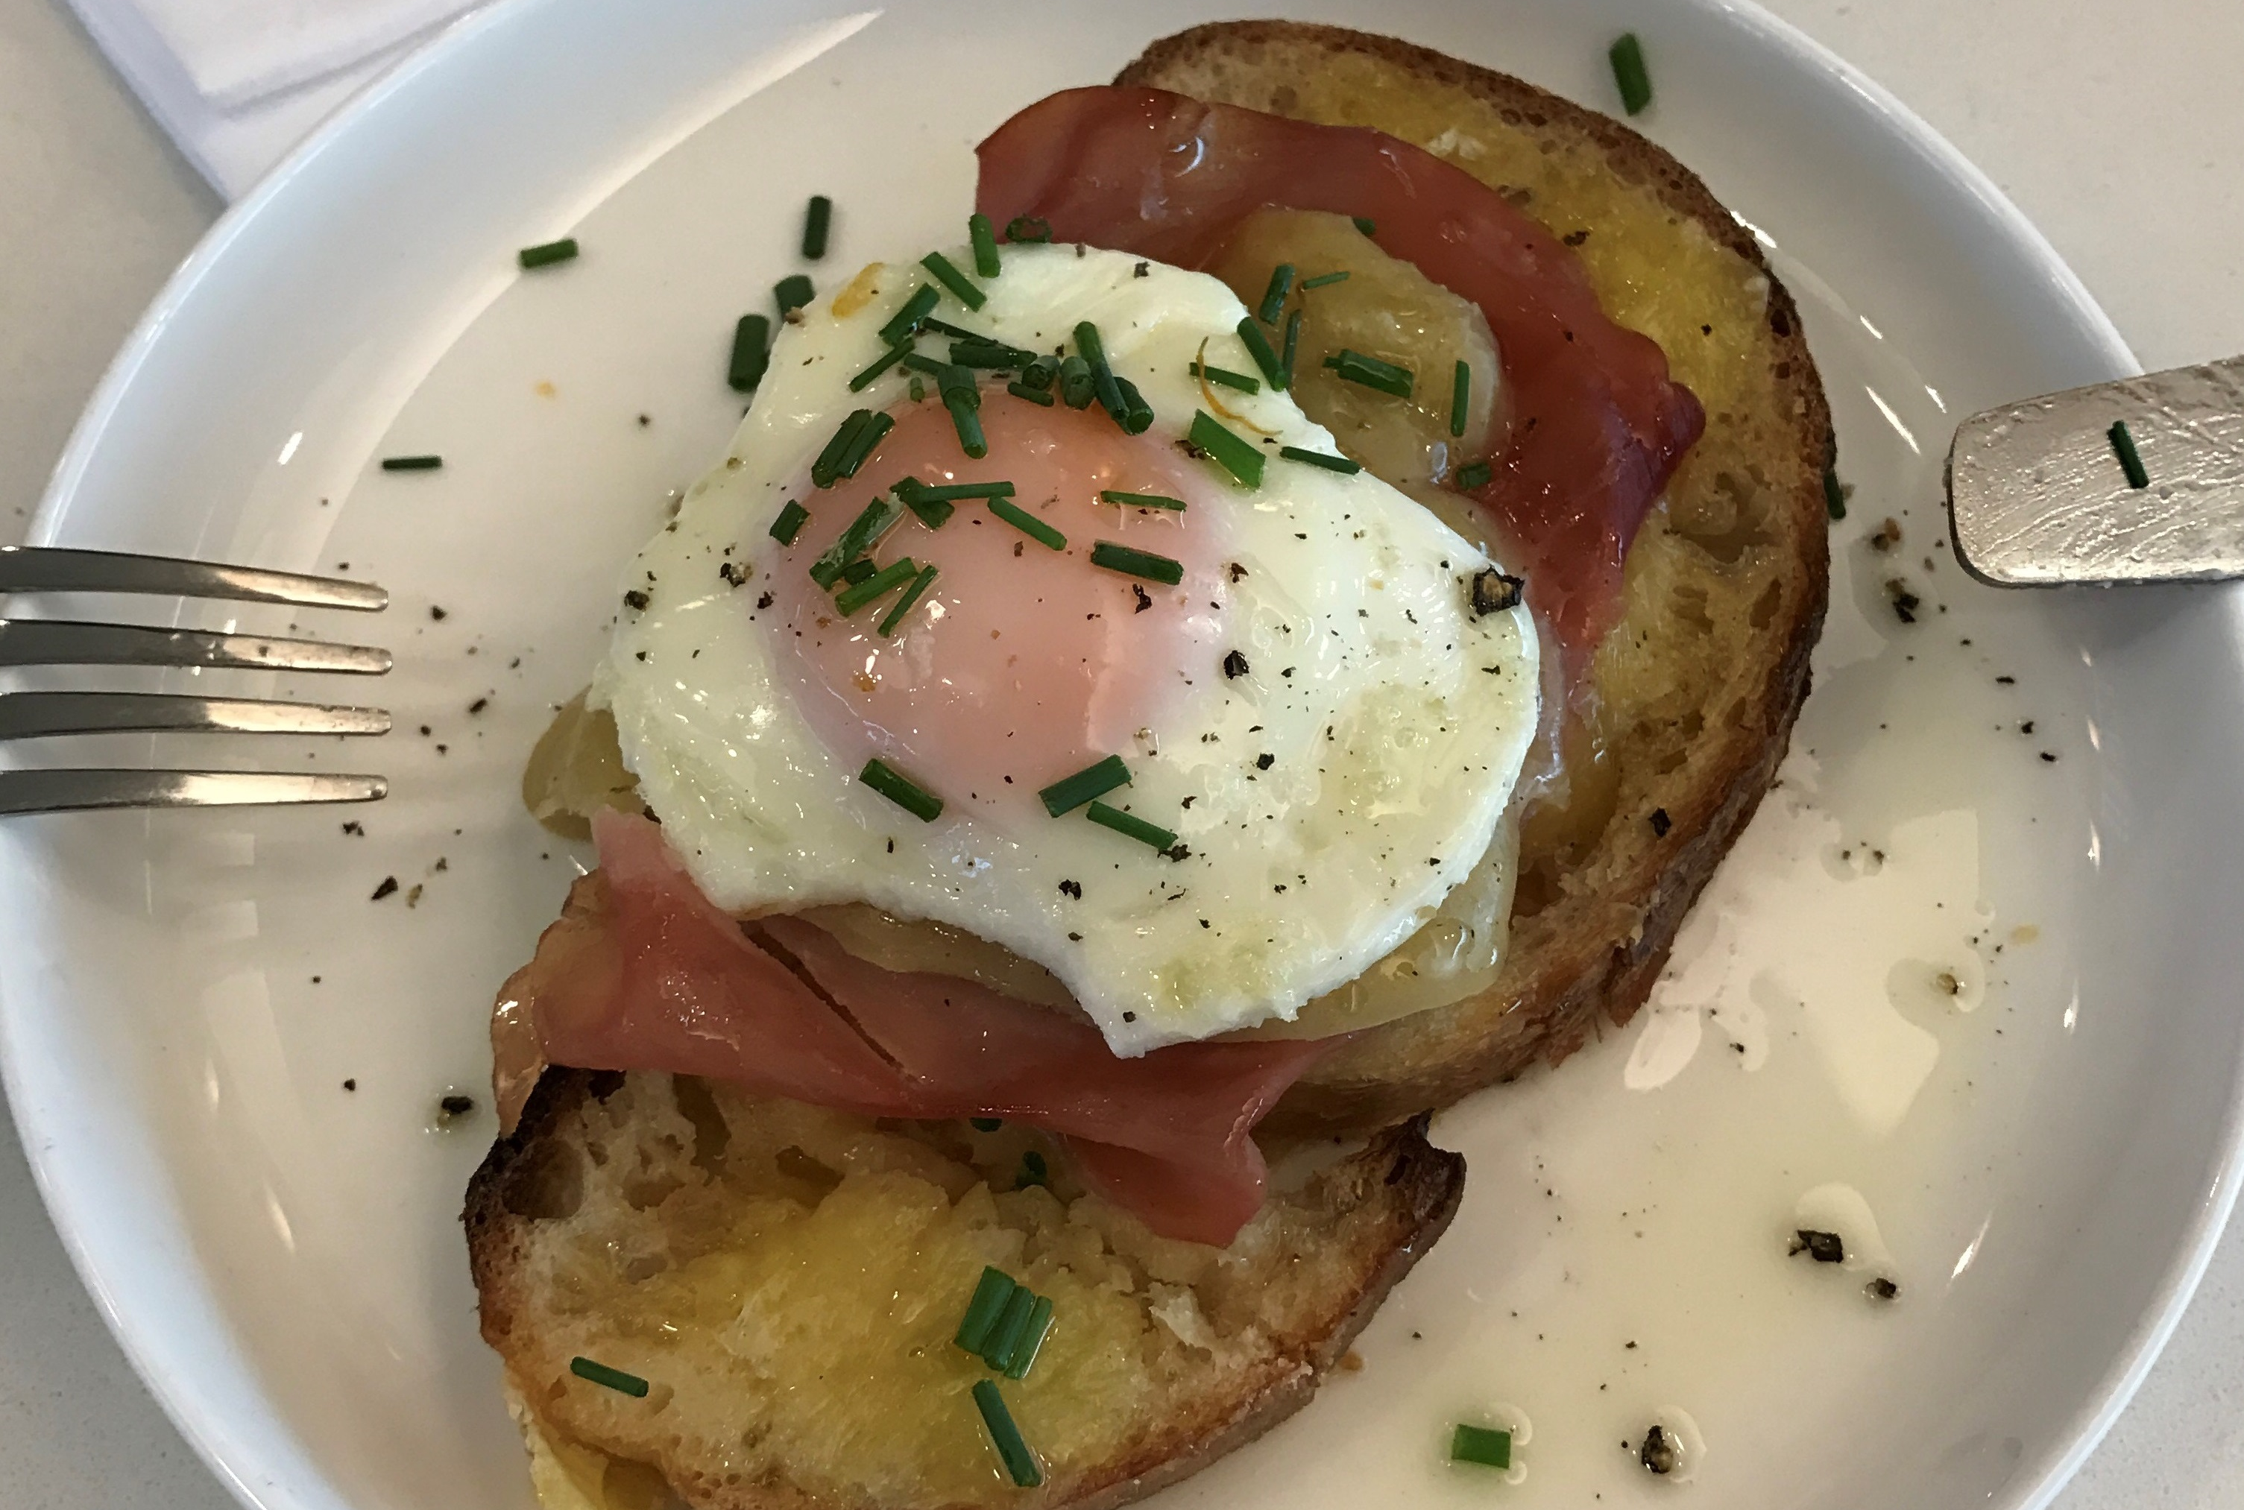
Hey Everyone! Look at my Breakfast!
BORING

Slide 11
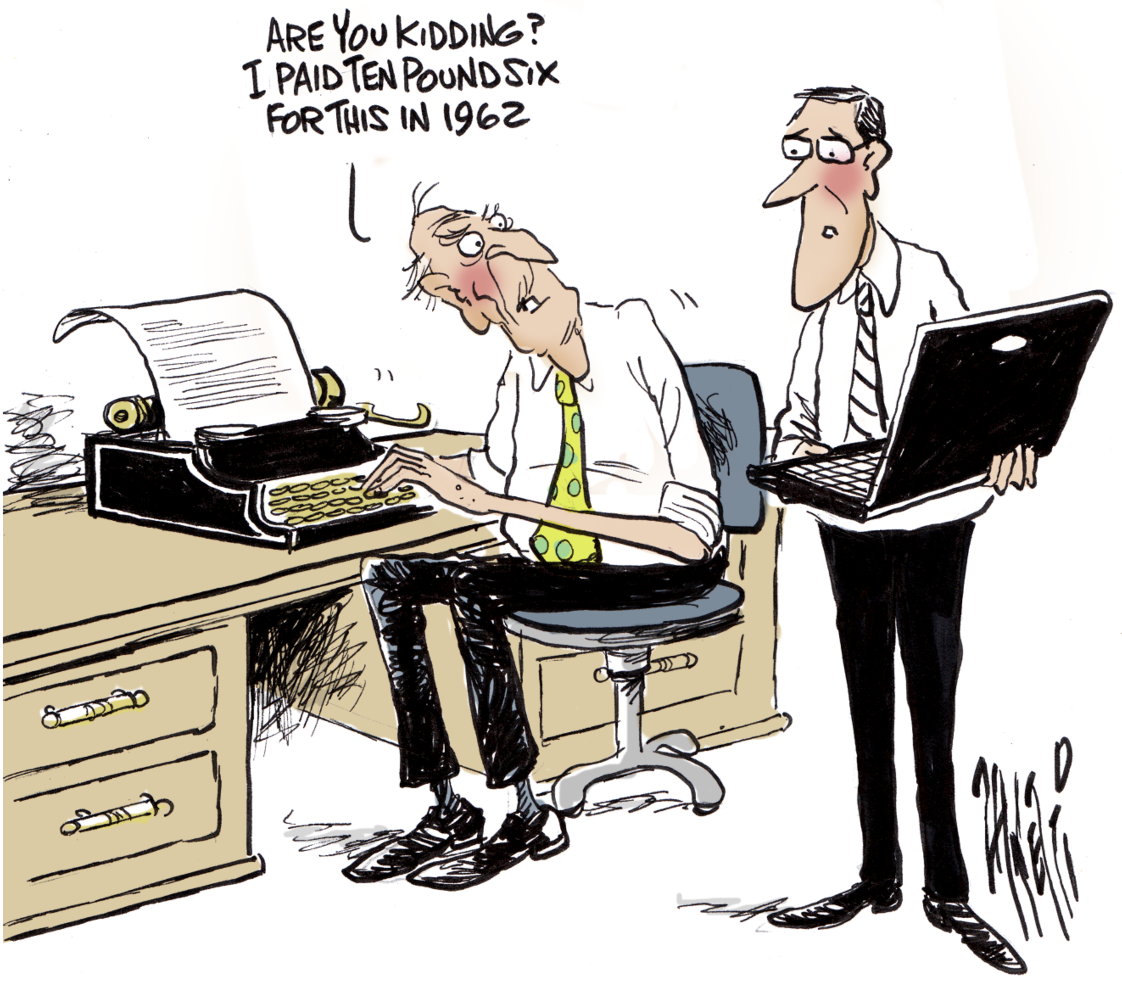
Get Past Your Past

Slide 12
Use Traditional and Social Media

Slide 13
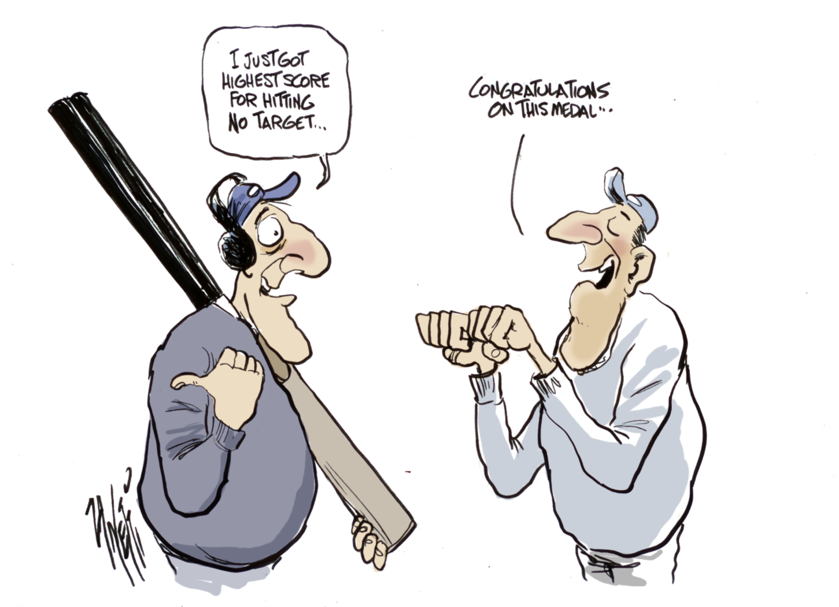
Set Targets to Measure Success

Slide 14
Use Relevant Language

Slide 15
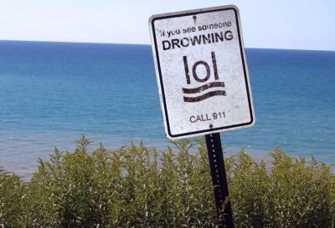
Use Relevant Language

Slide 16
MOST IMPORTANTLY
Get started!
A good plan, started today, is better than a perfect plan started tomorrow…

Slide 17
Western Division Councils of NSW Annual Conference Use of Social Media in Local Government
Information and Images
Copyright © 2019 Mathew Dickerson
All rights reserved

