Slide 1
Update on Murray-Darling Basin Plan Russell James Executive Director Office of Compliance 26 February 2019

Slide 2
What we do
Progress with Basin Plan
Climate / hydrology
Menindee Lakes & Fish Deaths
Response to SA Royal Commission

Slide 3
What we do
The MDBA
Develop Basin Plan and ensure compliance
Operate the River Murray System
Partnership with Basin state governments
Commonwealth Environmental Water Holder
Department of Agriculture and Water Resources

Slide 4
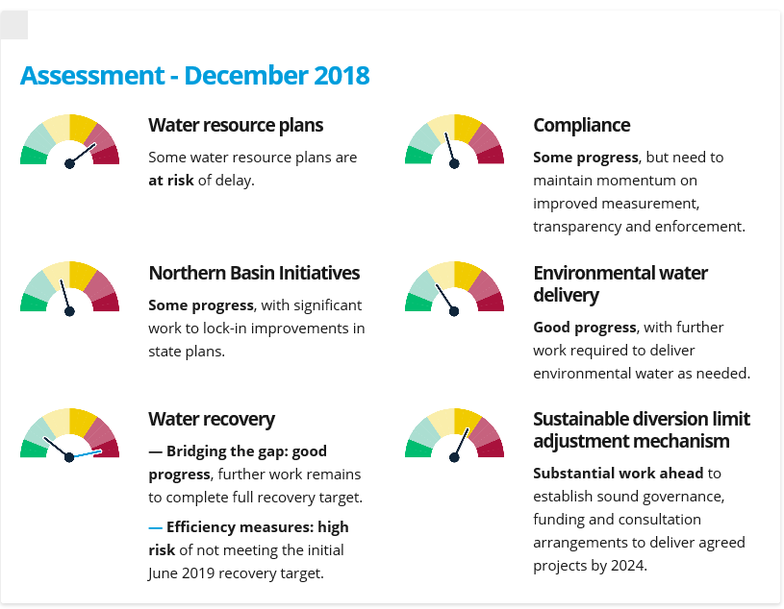
Progress with Basin Plan - 2018 Report Card
https://www.mdba.gov.au/sites/default/files/pubs/MDBA-2018-report-%20card-basin-plan-implementation.pdf

Slide 5
Menindee Lakes and Fish Deaths

Slide 6
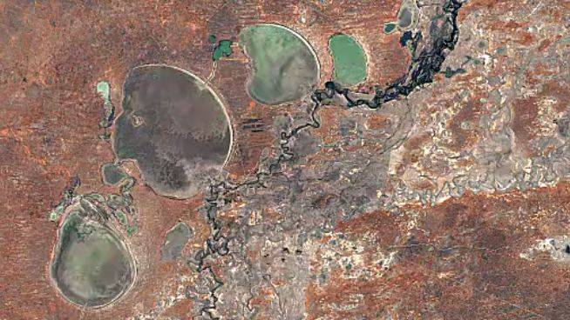
Menindee Lakes

Slide 7
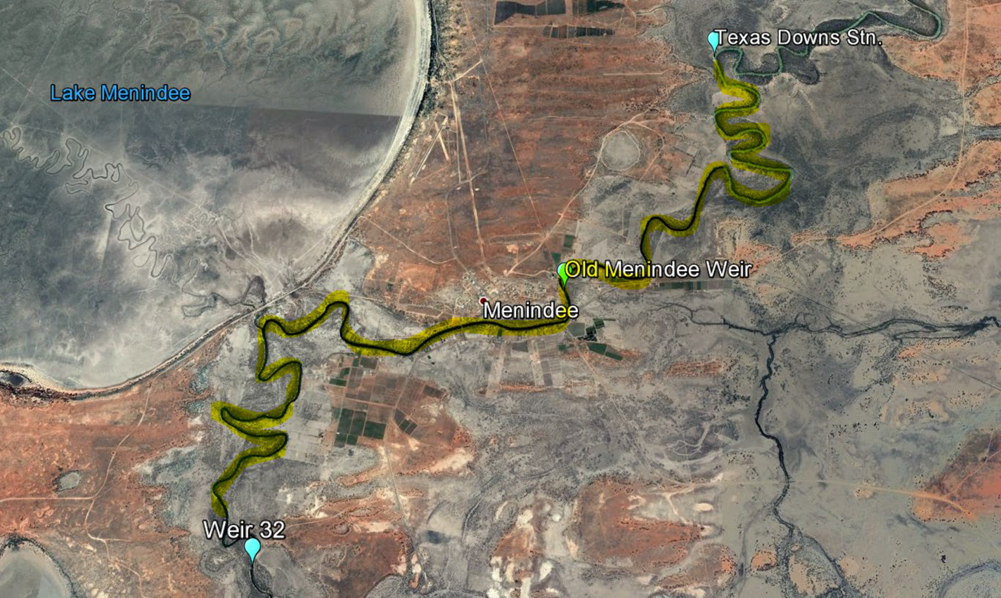
Fish Deaths- Extent
Notes:
About 40-50km of river above Weir 32…

Slide 8
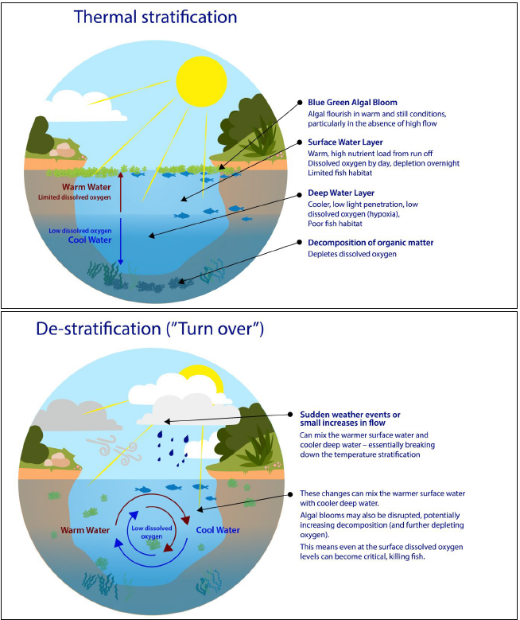
Causes
Notes:
Pictures show stratification or separation of water as a result of temperature and reinforce the previous graphs that show the absence as a result of mixing.

Slide 9
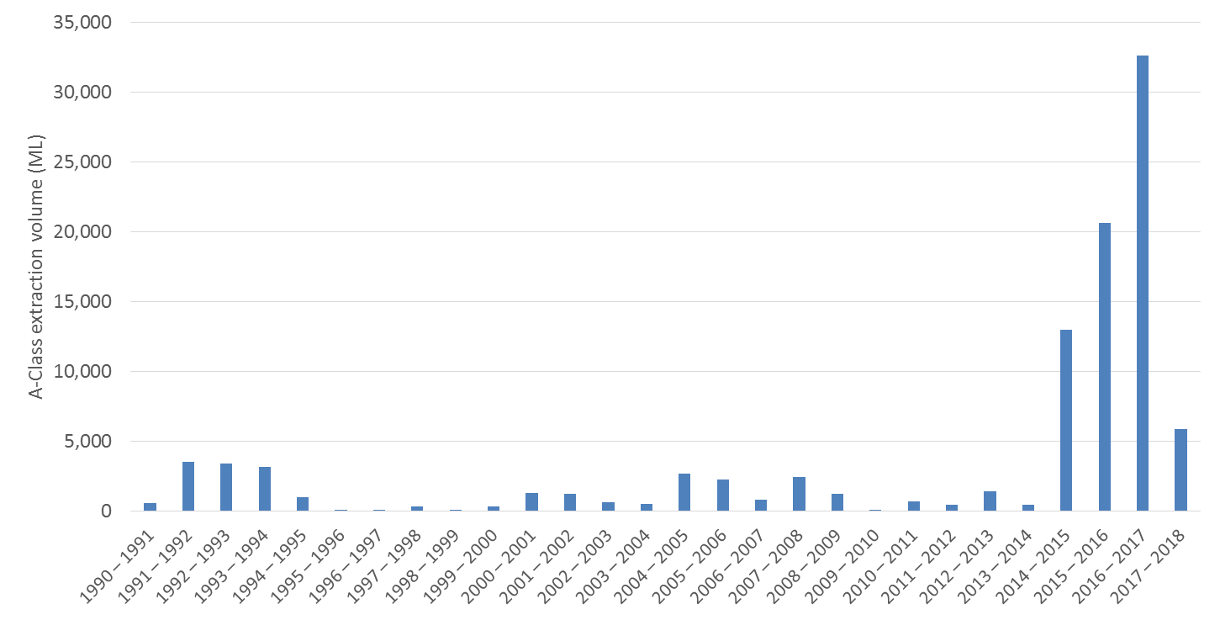
Annual A-class extractions – Barwon-Darling
Notes:
Figure 1: Annual A-class extraction volume, sourced from NSW DPI (pre-2012) and the NSW Water Register (post-2012)

Slide 10
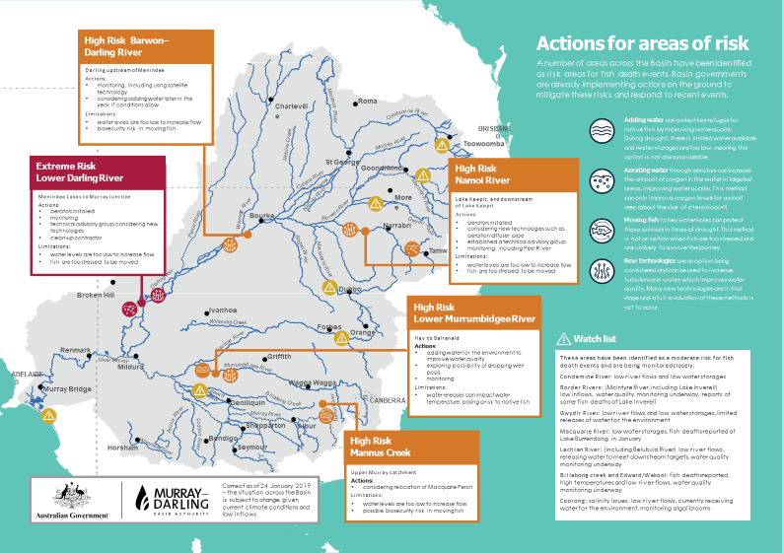

Slide 11
Response to SA Royal Commission
Effectively recommends starting Basin Plan again – a disaster
Basin Plan is a good starting point
When Basin Plan implemented we will have
around 20% or equivalent less extraction on average
more efficient irrigation
better protection of environmental flows
MDBA rejects RC claims re maladministration / unlawfulness
Plan made lawfully
No findings of improper conduct by anyone (including MDBA)
Use of best available science / transparency – accept we can do better
Best option is to stay the course – address challenges ahead – and continue to adapt in light of new information.

Slide 12
Thank you.

